Slide 1
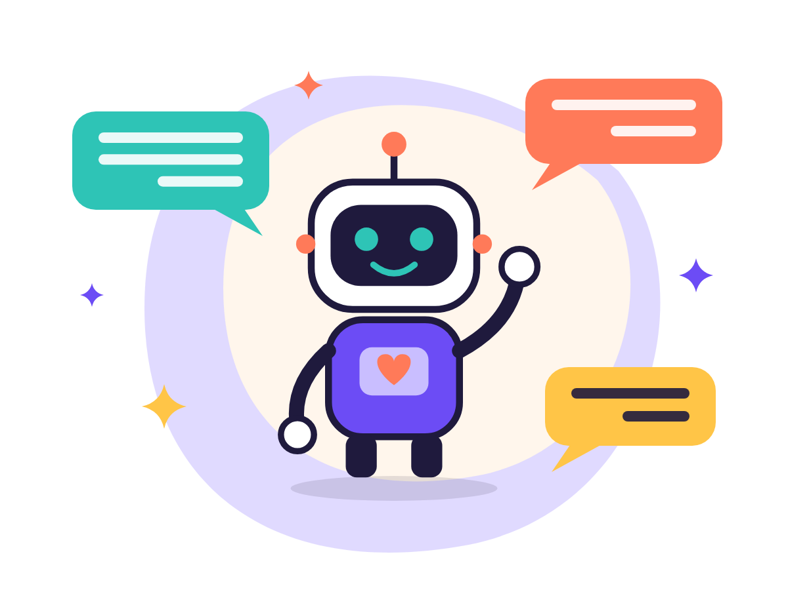
A COURSE FOR ABSOLUTE BEGINNERS
Introduction
to AI
20 daily lessons · 4 weeks · about 30 minutes a day
No experience, no powerful computer, just a browser and curiosity
Start today
© All rights reserved to Amram Abramovich / Olam HaChesed. No part of this material may be copied, reproduced, distributed, photographed, translated, sold or used in any way, in whole or in part, without prior written permission from the copyright holder. This material is intended solely for the personal use of those who purchased the course or received permission.
לקבלת אישורים / For permissions: 050-303-4614 · admin@olamhachesed.com
© Amram Abramovich · Olam HaChesed · All rights reserved

Slide 2
This course is for you, even if you've only heard the word AI
No unexplained jargon, no silly questions, and nothing you can break
Not needed
Needed
What you get
A technical background
A powerful computer or software
Money: the free plans are enough
A phone or computer with a browser
About 30 minutes a day
Willingness to try and make mistakes
20 real creations of your own
Confidence with the leading tools
Protection from scams, and privacy
© Amram Abramovich · Olam HaChesed · All rights reserved

Slide 3
A little every day: that's how confidence grows
A suggested pace, but everyone moves at their own speed
20
4
30
12
daily lessons
weeks × 5 days
minutes per lesson on average
hours in total (incl. project)
Fast: 2 lessons a day → 2 weeks · Recommended: 1 lesson a day → 4 weeks (about 2.5 hours a week) · Relaxed: 3 a week → about 7 weeks
© Amram Abramovich · Olam HaChesed · All rights reserved

Slide 4
The journey: from your first chat to a final project
Week 1 · Getting to know AI
Week 2 · Everyday assistant
Week 3 · Creative AI
Week 4 · AI that does work
1
What is AI, anyway?
6
Conversation, not orders
11
AI that draws
16
Research with sources
2
Create an account
7
Writing at home & work
12
Invitation and card
17
A smart notebook
3
The 4-part formula
8
Snap, upload, ask
13
Songs and voices
18
Code without code
4
How computers learn
9
Learn anything
14
Your first video
19
Agents and new words
5
AI makes mistakes
10
4 assistants, 1 task
15
Real or fake?
20
Final project!
© Amram Abramovich · Olam HaChesed · All rights reserved

Slide 5
Every lesson follows the same 6 steps
20–40 minutes, and it always ends with something you made
1
2
3
4
5
6
The idea
New words
Step by step
Prompts
I made it!
Quick quiz
One concept + an everyday comparison
1–3 new terms
Exact instructions in the tool
Ready-to-copy requests
A real result of your own
3 questions to lock it in
Every day you walk away with something real: a greeting, a table, a picture, a song, a video, a web page.
© Amram Abramovich · Olam HaChesed · All rights reserved

Slide 6
WEEK 1
Getting to know AI
Lose the fear and talk to AI for the first time
Day 1 · What is AI, anyway?
Day 2 · Create an account and start talking
Day 3 · The art of asking
Day 4 · How does a computer "learn"?
Day 5 · AI makes mistakes, so we check
© Amram Abramovich · Olam HaChesed · All rights reserved

Slide 7
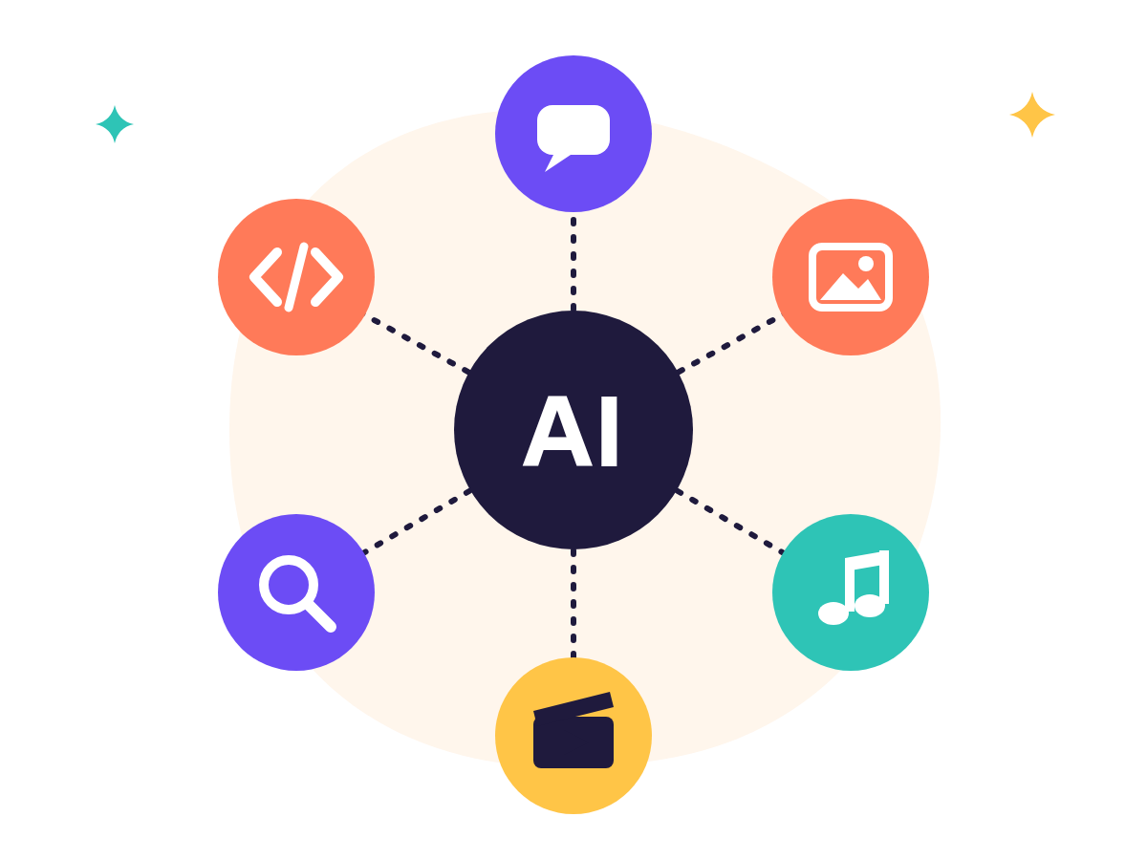
"AI" is a general word, like "vehicle"
Toyota and Kia make cars; OpenAI, Google and others make AI assistants
Kind of AI | What it does | Examples
Chats and writes | Answers, writes, summarizes, translates | ChatGPT, Gemini, Claude, Grok
Draws | Pictures from a description | Inside the chats, Canva
Speaks and sings | Voice-overs and songs | ElevenLabs, Suno
Films | Short videos | Veo, Grok Imagine, Runway
Searches and researches | Answers with sources | Perplexity, Deep Research
Writes code | Small web pages | Canvas, Artifacts
© Amram Abramovich · Olam HaChesed · All rights reserved

Slide 8
Four chat assistants, all with a free plan
Day 2: open one or two accounts. No credit card needed.
ChatGPT
Gemini
Claude
Grok
by OpenAI
by Google
by Anthropic
by xAI
chatgpt.com
gemini.google.com
claude.ai
grok.com
Sign up → Google / Apple / email → verify → name and date of birth
Sign in with your Google account (the same as Gmail)
Sign up with Google or email; you may need to verify a phone number
Sign up with Google, Apple, email or an X account
Screens change often. Can't find a button? Look for Sign up / Log in / Continue, or ask the AI itself. Apps: only from the official store and the original developer.
© Amram Abramovich · Olam HaChesed · All rights reserved

Slide 9
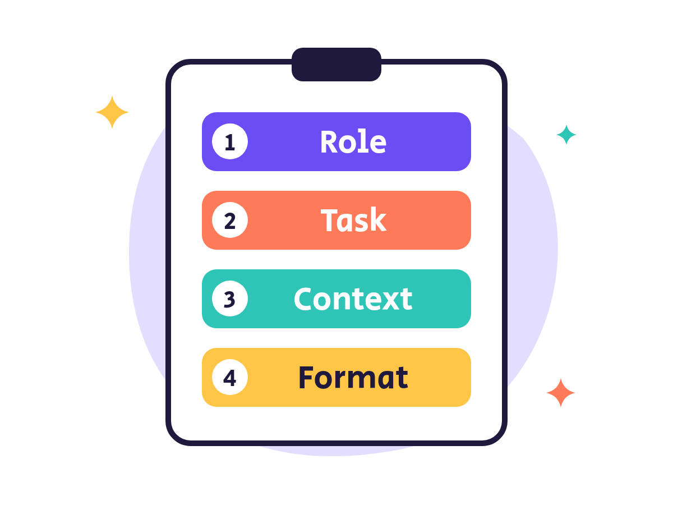
A good request = a good answer
The 4-part formula: Role · Task · Context · Format
Weak: "Write a greeting"
Strong: "You're a professional card writer. Write a short, warm 4-line birthday message for my sister Emma, who loves hiking and baking. Light-hearted, with a little humor."
Golden tip: "Before you answer, ask me 3 questions that will help you."
© Amram Abramovich · Olam HaChesed · All rights reserved

Slide 10
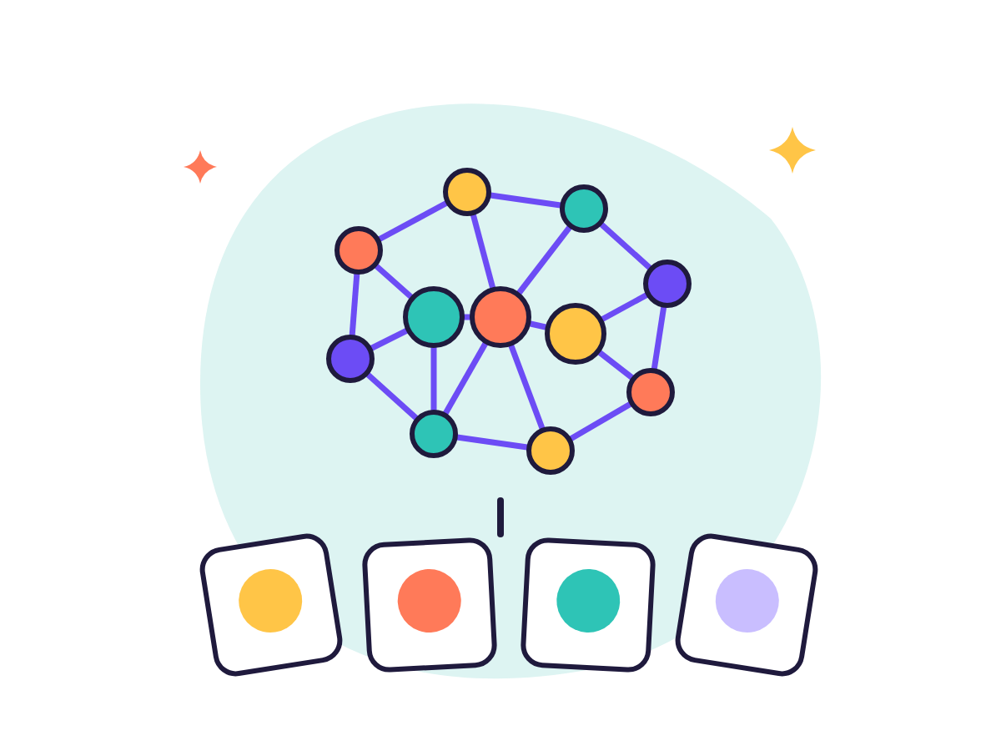
Computers learn from examples
Like a child who learns what a "dog" is after seeing many dogs
1
Examples
Huge amounts of text, pictures and sound
2
Training
The computer finds patterns, over months
3
Model
The resulting "brain", like a recipe after a thousand tries
An LLM predicts the next token (a word or part of a word), like phone autocomplete. Parameters are billions of tiny "knobs" tuned during training.
© Amram Abramovich · Olam HaChesed · All rights reserved

Slide 11
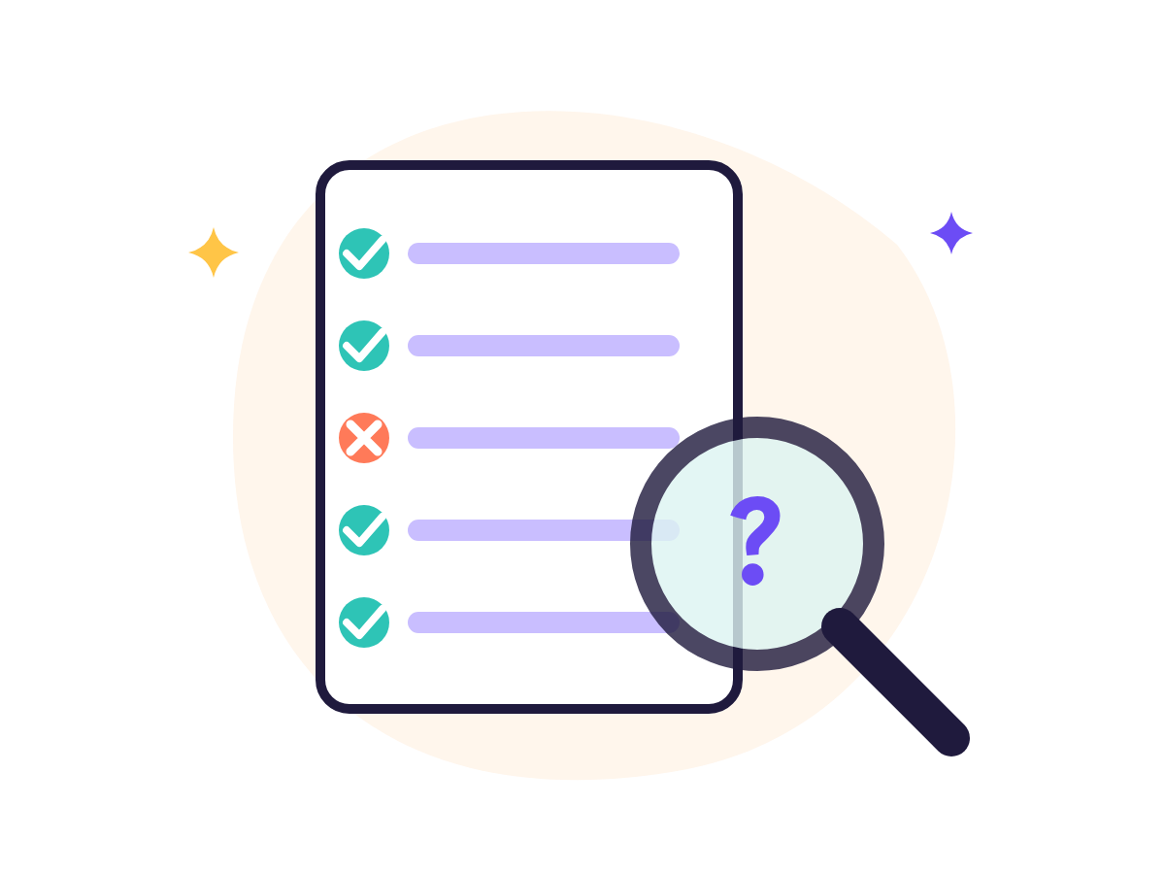
AI can make things up, so we check
A "hallucination" = wrong information that sounds convincing
1
Ask for a source
"Where's this from? Give me a link."
2
Open the link
Does it exist? Does it really say that?
3
Cross-check
Google, an official site, a second source
Always check: health, money, legal matters and safety. AI is no substitute for a doctor or lawyer.
© Amram Abramovich · Olam HaChesed · All rights reserved

Slide 12

WEEK 2
Your everyday assistant
Planning, writing, documents and learning
Day 6 · Have a conversation, don't give orders
Day 7 · Writing at home and at work
Day 8 · Snap, upload and ask
Day 9 · Learn anything with AI
Day 10 · Four assistants, one task
© Amram Abramovich · Olam HaChesed · All rights reserved

Slide 13
The first answer is a draft. Keep talking.
The AI remembers what was said in the same chat, so just ask for the change
"Shorter"
"In simpler words"
"Give me 3 options"
"Put it in a table"
"More formal"
"What's missing?"
"Just swap Tuesday"
"Ask me questions first"
Day 6 exercise: "In my fridge I have eggs, tomatoes, chicken, rice and zucchini. Plan 5 dinners for a family of 4, 40 minutes or less each, as a table." Then 3 rounds of improvements and a shopping list.
© Amram Abramovich · Olam HaChesed · All rights reserved

Slide 14
AI writes the draft. You decide and send.
The request
Uses worth trying
"My internet provider charged me twice. Write an email to customer service: polite but firm, under 120 words. Instead of personal details, write [name], [account number], [amount]."
An awkward email, in the right tone
Two versions: "gentle" and "firm"
Fixing mistakes without changing the meaning
A simple, polite translation
A post for a small business
A check: "Does anything sound rude?"
[name]
[account number]
[amount]
Replacing identifying details = anonymizing
Before sending: read it, fix it, and add the real details yourself.
© Amram Abramovich · Olam HaChesed · All rights reserved

Slide 15
Snap, upload and ask: AI can see and read too
Multimodal = understands text, pictures, sound and video
The sample letter (made up)
Public terms of service
A garden plant
A menu abroad
"What do they want from me, and by when?"
"The 7 key points for a customer"
"Why are the leaves turning yellow?"
"Translate it and suggest meat-free dishes"
How: click + or "Attach" next to the message box → choose a file or the camera → type what you want
Before uploading: hide your name, ID number, account number and address. Medical documents: understand the terms, decide only with your doctor.
© Amram Abramovich · Olam HaChesed · All rights reserved

Slide 16
There's no "best", only "best for me"
Day 10: the same prompt in four assistants, then choose your "home tool"
Assistant | Company | Stand-out strengths | Free | Paid tier (approx.*)
ChatGPT | OpenAI | The popular all-rounder: writing, images, voice, research | Yes | Go about $8 · Plus about $20
Gemini | Google | Works with Gmail and Drive, long documents, video | Yes | AI Plus about $5 · AI Pro about $20
Claude | Anthropic | High-quality writing, long documents, code | Yes | Pro about $20
Grok | xAI | Up-to-date info from the web and X, images and video | Yes | SuperGrok Lite about $10 · SuperGrok about $30
*Approximate prices in US dollars per month, before tax, as of October 2026. They vary by country and may change. You don't need a subscription to complete the course.
© Amram Abramovich · Olam HaChesed · All rights reserved

Slide 17

WEEK 3
Creative AI
Pictures, invitations, songs, videos, and spotting fakes
Day 11 · AI that draws
Day 12 · Designing an invitation and a card
Day 13 · Songs and voices
Day 14 · Your first video
Day 15 · Real or fake?
© Amram Abramovich · Olam HaChesed · All rights reserved

Slide 18
Words become pictures
The 5-part formula. In ChatGPT, Gemini or Grok: "Create an image of..."
Subject
A festive table with fruit and candles
Style
Watercolor
Lighting & mood
Warm evening light
Background
A blurred, cozy home
Shape
Landscape (16:9)
Image generators use "diffusion": they start from noise and clean it up step by step, like a sculptor chipping away stone.
© Amram Abramovich · Olam HaChesed · All rights reserved

Slide 19
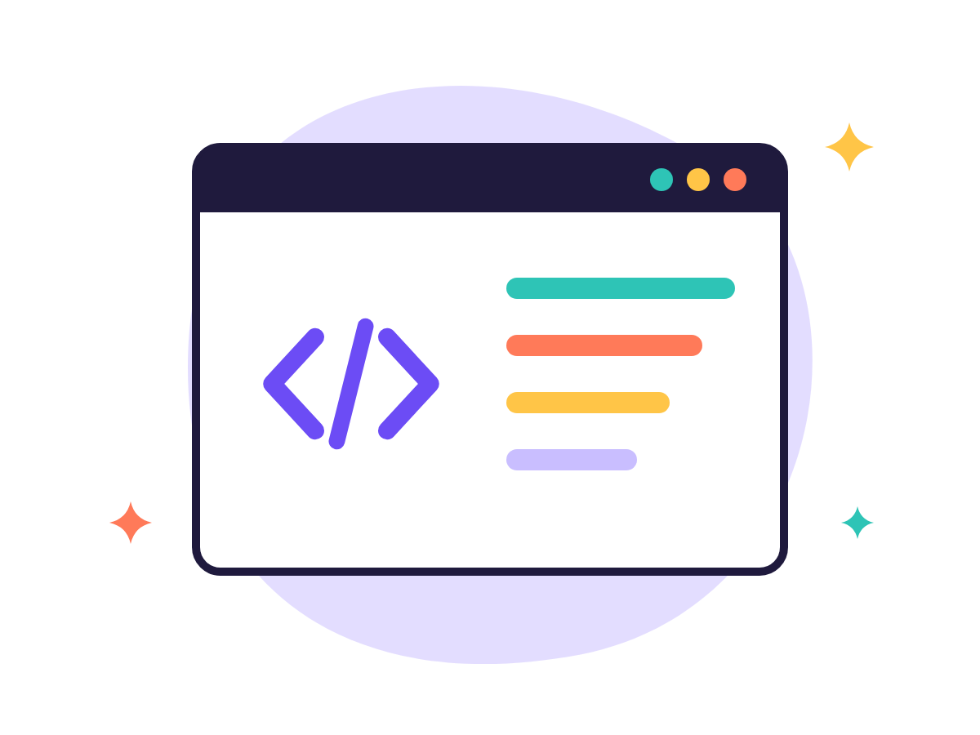
A designed invitation in three steps
Add the text in Canva: image generators still get names, dates and long text wrong
1
2
3
→
→
The wording
The picture
The design
Your chat assistant writes 3 versions: what, when, where, RSVP
"A festive watercolor background, lots of empty space, no writing at all"
On canva.com: an "Invitation" template, upload the picture, replace the text, download PNG/PDF
© Amram Abramovich · Olam HaChesed · All rights reserved

Slide 20
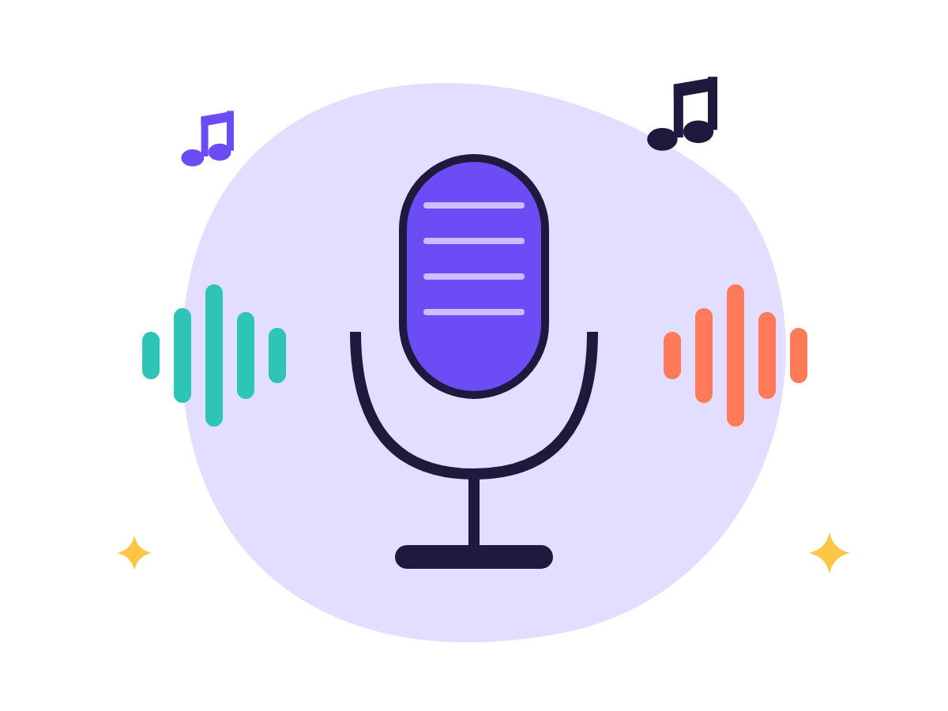
A personal song or voice-over
Day 13
Suno
ElevenLabs
A song with a tune and vocals from a description or lyrics. Free: a few songs a day. Pro about $10/month (approx.).
Natural-sounding voice-overs in many languages. Free: a small monthly allowance. Plans from about $6 (approx.).
Red line: clone only your own voice, or the voice of someone who gave explicit consent. Use songs commercially only as the terms allow.
© Amram Abramovich · Olam HaChesed · All rights reserved

Slide 21

Your first video: seconds of magic
Video is the most expensive area, so plan your prompt in advance
Formula: what you see · what moves and how · camera · mood
Tool | Where | Good to know (approx.)
Veo | Inside Gemini | Mainly on Google AI plans
Grok Imagine | Inside Grok | Pictures and short videos
Runway | runwayml.com | About 125 one-time free credits
"A sunflower field at sunset, the sunflowers swaying in the wind, the camera slowly moving closer, golden light, cinematic style"
© Amram Abramovich · Olam HaChesed · All rights reserved

Slide 22

3 rules against scams and fakes
Voices and pictures can be faked, as in the "grandchild in trouble, send money now" scam
1
A family code word
Agreed face to face, never by message
2
Call back
Hang up and dial the number you know
3
Don't rush
"Right now! It's a secret!" is a warning sign
A suspicious picture? Check who posted it, and do a reverse image search (Google Lens). Signs like "strange fingers" disappear as tools improve.
© Amram Abramovich · Olam HaChesed · All rights reserved

Slide 23
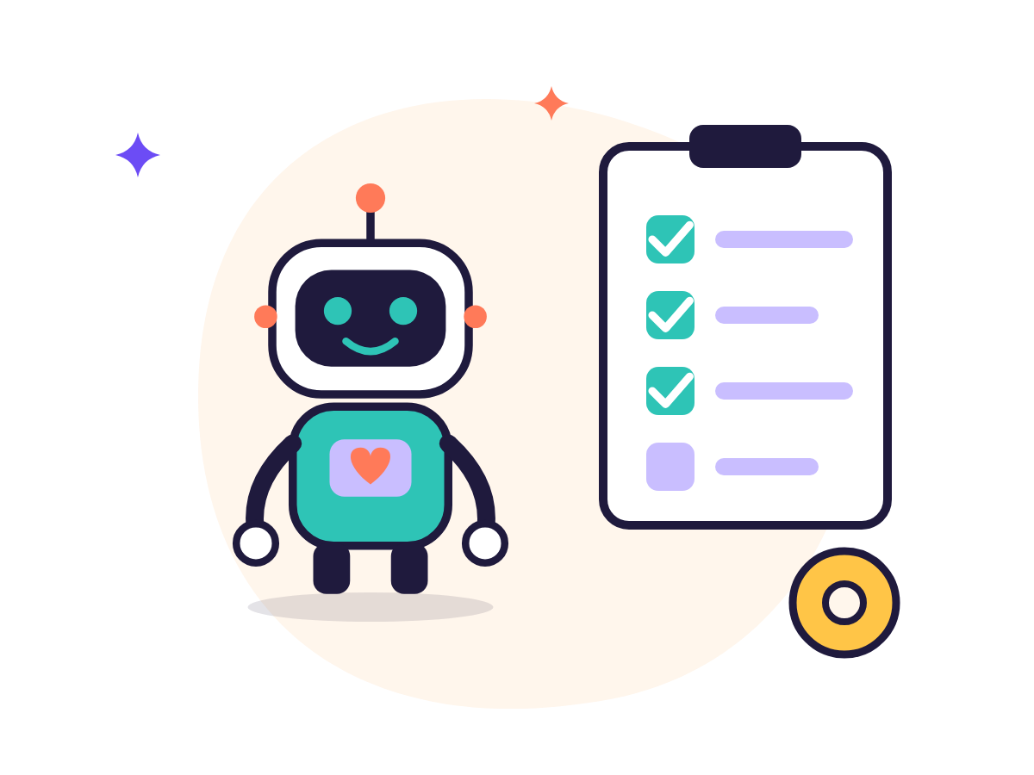
WEEK 4
AI that gets work done
Research, documents, code without code, agents and a final project
Day 16 · Search and research with sources
Day 17 · A smart notebook for your documents
Day 18 · "Code without knowing code"
Day 19 · Agents and words you'll hear
Day 20 · Final project and celebration
© Amram Abramovich · Olam HaChesed · All rights reserved

Slide 24
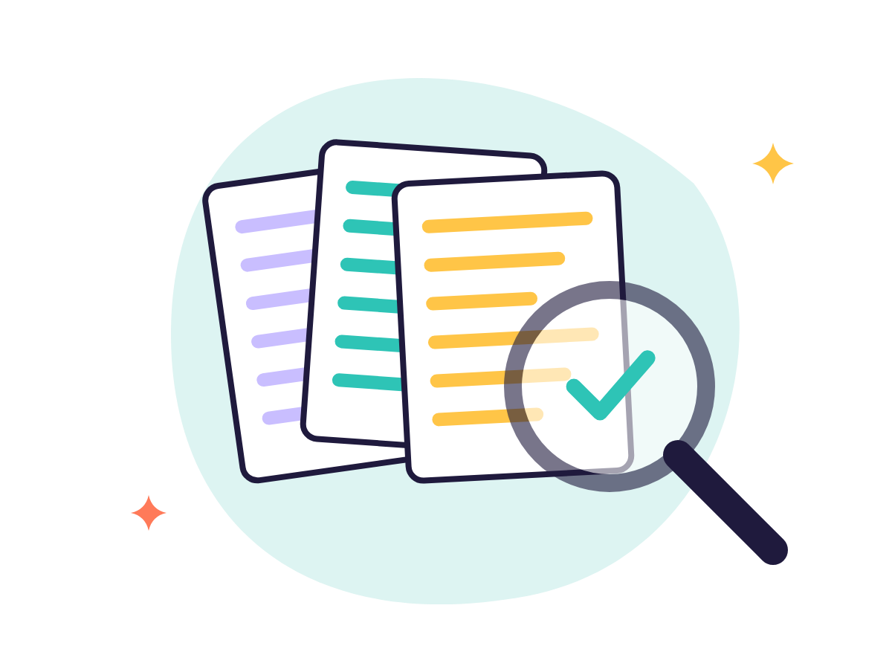
Answers with sources
Like an open-book exam: the AI searches first, then answers. And we still check.
Perplexity
A quick question → a short answer with numbered sources
Chat search
ChatGPT, Gemini, Claude and Grok search the web
Deep Research
Reads dozens of sources and writes a report with links
The task: a short report on a trip destination. Open 3 links and mark ✓ / ✗.
© Amram Abramovich · Olam HaChesed · All rights reserved

Slide 25
Your documents, and an app without code
Gemini Notebook · Day 17
Code without code · Day 18
notebook.google.com with a Google account
Add 1–3 sources: PDF, website, YouTube
Ask, and see where every sentence came from
Audio Overview: a short podcast about your material
Canvas in ChatGPT and Gemini, Artifacts in Claude
"Build a birthday greeting page with a confetti button"
See a preview and improve it in plain words
Publish = a public link: nothing private on the page
© Amram Abramovich · Olam HaChesed · All rights reserved

Slide 26
An agent doesn't just answer, it acts
An adviser vs. a personal assistant who also gets things done
Scheduled task: "Every Sunday at 8:00, 3 dinner ideas"
Custom assistant: Gems in Gemini, Projects in ChatGPT and Claude
Safety rule: no passwords, card details or sending in your name without approval
Words you'll hear | In short
Open source vs. closed | A cookbook recipe vs. a restaurant dish
Local vs. cloud | On your computer (needs a powerful one) vs. at the company
Reasoning model | Thinks step by step before answering: slower, more careful
API · Fine-tuning | Going further: a "socket" for software · a model specializing
© Amram Abramovich · Olam HaChesed · All rights reserved

Slide 27

Final project: an AI event kit
A birthday, holiday dinner, reunion or launch. About 2 hours, over a few days.
1
Planning
Schedule, tasks and budget in a table
2
Designed invitation
Original picture + Canva
3
Greeting or speech
With the 4-part formula
4
Song or voice-over
Suno / ElevenLabs
5
Checks and safety
Facts, privacy, AI disclosure
Bonus: web page · video · research
© Amram Abramovich · Olam HaChesed · All rights reserved

Slide 28
5 golden rules for life
1
2
3
4
5
An assistant, not an oracle
Privacy first
Have a conversation
Respect people
Have fun
Check numbers, names and sources
No ID numbers, cards, passwords or medical details
"Shorter", "3 options", "Ask me first"
No picture or voice of a real person without permission
No silly questions. AI never judges
© Amram Abramovich · Olam HaChesed · All rights reserved

Slide 29
Start free. Subscribe only if something's missing.
All prices are approximate, in US dollars per month, before tax, as of October 2026, and subject to change
Category | Tool | Free? | Plan (approx.)
Chat assistants | ChatGPT · Gemini · Claude · Grok | Yes | Around $20 (cheaper tiers exist too)
Search | Perplexity | Yes | Pro about $20
Documents | Gemini Notebook | Yes | Extra features with Google AI plans
Design | Canva | Yes | Pro, price varies by country
Music and voice | Suno · ElevenLabs | Limited | About $10 · from about $6
Video | Runway | One-time credits | From about $12–15
Check the official pricing page before buying. Prices vary by country and are updated every few months.
© Amram Abramovich · Olam HaChesed · All rights reserved

Slide 30
Congratulations!
Twenty days ago you'd only heard the word AI. Today you chat, write, design, compose, research and build, and you do it safely.
What's next: 10 minutes a day with your prompt library · a new tool once a month · teach someone the 4-part formula
© Amram Abramovich · Olam HaChesed · All rights reserved

